Slide 1


THE BARUCH LOUSADAS WERE PART OF THE WESTERN SEPHARDIC DIASPORA
1540-1743

Slide 2
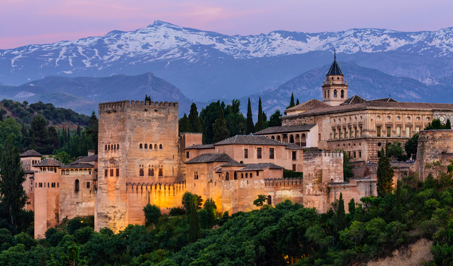
THIS (MAINLY PORTUGUESE) STORY STARTS IN SPAIN
GRANADA APPEARS IN LOUSADA RECORDS FROM JAMAICA BUT
  IT WAS THE LAST PART OF MUSLIM SPAIN FALLING IN 1492
  JEWS FARED WELL ENOUGH UNDER THE UMAYYADS AND ESPECIALLY THE CULTURED ABBASIDS BUT LESS SO UNDER THE MORE FANATICAL ALMOHADS AND ALMORAVIDS
  OUR ANCESTORS MAY HAVE MOVED TO CHRISTIAN SPAIN BEFORE 1492
1492 – ALSO A MOMENTOUS YEAR BECAUSE IN THIS YEAR
  COLUMBUS DISCOVERED NEW WORLD
  UNCONVERTED JEWS EXPELLED FROM SPAIN - ½ TO PORTUGAL

Slide 3
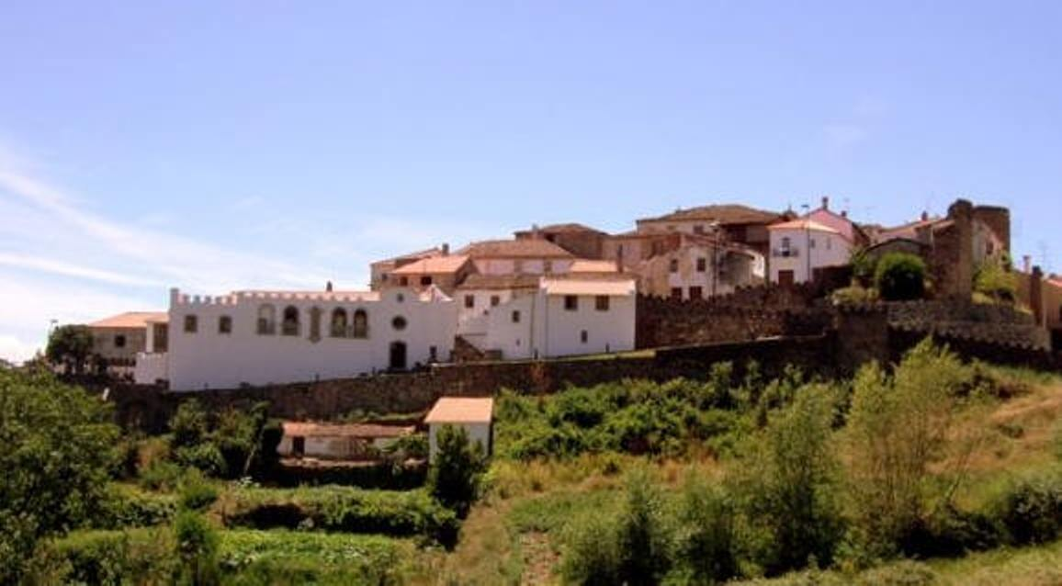
WHAT PORTUGAL MEANT TO US
RELIGIOUS PROBLEMS
  CONVERSION IN 1497
  2 ENCOUNTERS WITH COIMBRA INQUISITION (1580, 1650)
  (LEADING TO MODERN LEGAL REDRESS)
SEVERAL EXITS TO SPAIN
  AND THEN ELSEWHERE
PORTUGUESE COMMONLY USED IN TRADE AND OTHER DOCUMENTS UNTIL 1750

Slide 4
OUR PORTUGUESE LOCATIONS
BAPTISM IN LOUSADA
1st CERTAIN DATE – AMADOR DE LOUSADA OF VINHAIS WAS BORN 1540 TO PEDRO DE LOUSADA AND BRIATIS ALVARES
A SHORT STAY IN BRAGANZA
A LONG STAY IN VINHAIS
STRONG CONTACT WITH VILLAFLOR FAMILIES

Slide 5
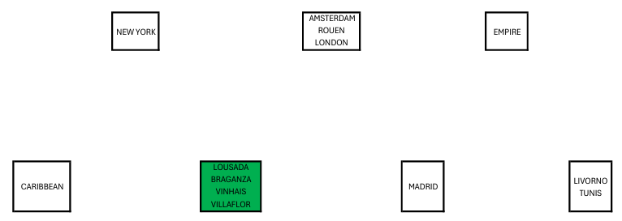
A LONG PAUSE IN PORTUGAL
1492-1630

Slide 6
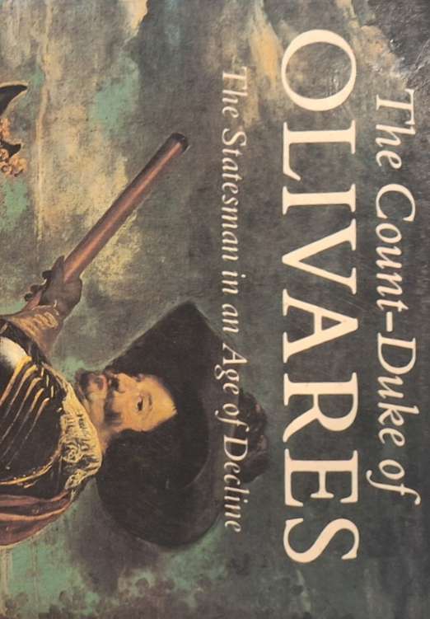
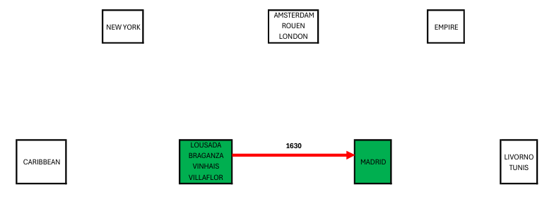
TO MADRID circa 163O

Slide 7
TO MADRID 163O
THANKS TO STRONG LINKS WITH VILLAFLOR FAMILIES
WITH SEVERAL MARRIAGES
  PROBABLY IN VILLAFLOR
  AS WELL AS MADRID

Slide 8
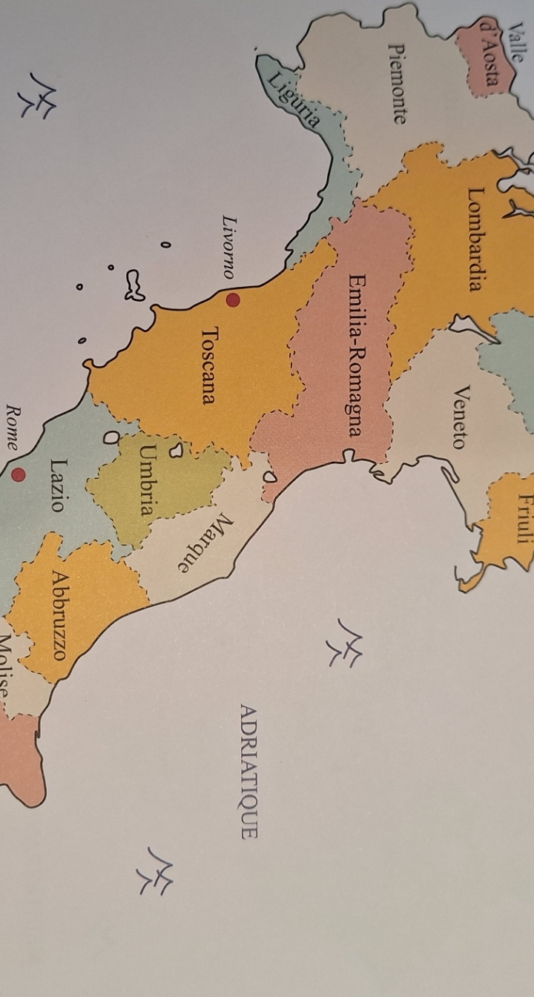
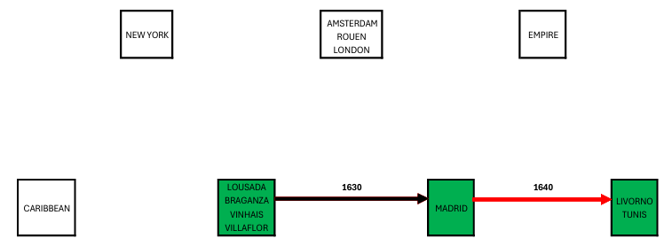
TO LIVORNO
1640

Slide 9
WHY LIVORNO?
BOOM PORT FROM 1590s START
CARGOS EXCHANGED IN SUCH PORTS KEPT LIQUID ASSETS OUT OF SPAIN

Slide 10
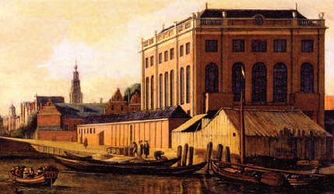
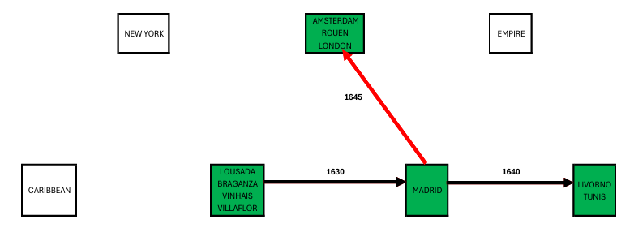
TO AMSTERDAM
1645

Slide 11
DEPARTING PORTUGUESE NEW CHRISTIANS
WOULD IDEALLY LEAVE BEHIND IN MADRID
  GOVERNMENT PAPER (WHICH BECAME WORTHLESS AFTER CROWN BANKRUPTCY OF 1647)
  DEBTS SECURED AGAINST SUCH PAPER HENCE UNHAPPY CREDITORS
  A FRUSTRATED SPANISH INQUISITION WITH NO ASSETS TO CONFISCATE
ONE SUCH WEALTHY DEPARTEE WAS
  TOMAS RODRIGUES PEREIRA b VILLAFLOR circa 1606
  BECAME ABRAHAM ISRAEL PEREIRA IN AMSTERDAM
  HAD BARUCH LOUSADAS IN HIS ORBIT (AMSTERDAM, ROUEN, BAYONNE, LIVORNO)
  NEPHEW OF THE ISAAC BARUCH LOUSADA SENT TO LIVORNO IN 1640

Slide 12
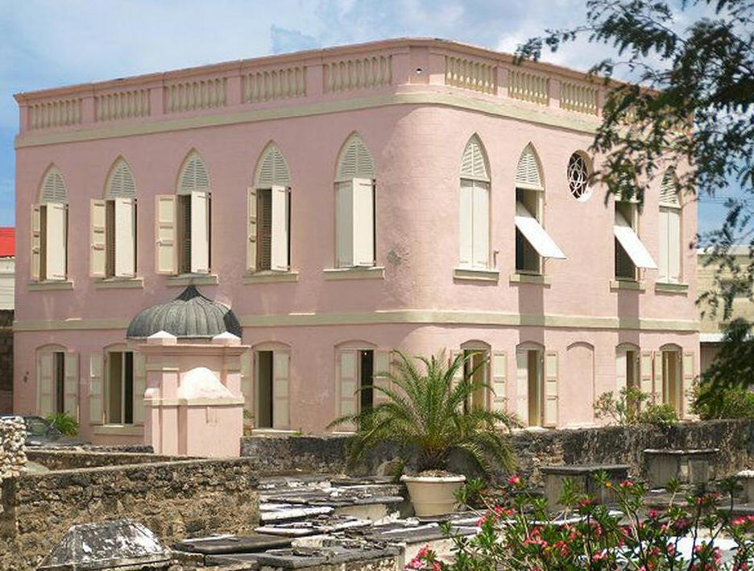
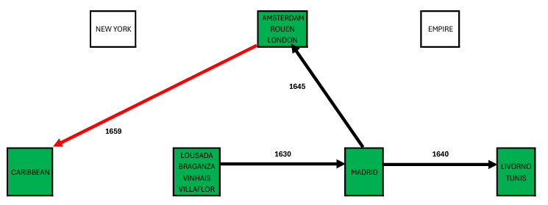
TO BARBADOS
1659

Slide 13
WHY BARBADOS?
DUTCH OUSTED FROM BRAZIL 1654
  JEWS WERE PROMINENT AMONG DUTCH SUGAR PLANTERS AND PROCESSORS
  MOST HEADED FOR AMSTERDAM WITH INDUSTRY KNOWLEDGE INCLUDING BARBADOS POTENTIAL
  THE MERCADOS WERE ONE SUCH FAMILY – AND GOT PASS FROM CROMWELL TO GO TO BARBADOS IN 1655
ABRAHAM ISRAEL PEREIRA EXCITED BY SUGAR
  INVESTED IN A REFINERY IN AMSTERDAM
  MARRIAGE LINK BETWEEN MERCADOS AND BARUCH LOUSADAS BY 1659

Slide 14
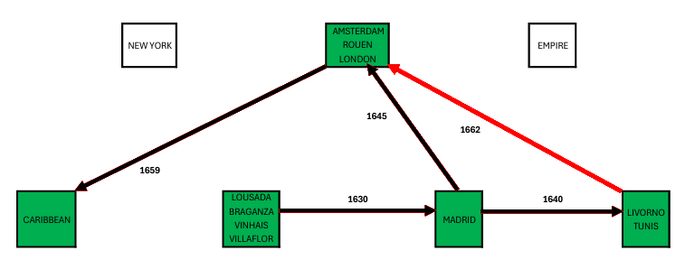
FIRST EXIT FROM LIVORNO
1662

Slide 15
AFTER 1662 DEPARTURE
ISAAC BARUCH LOUSADA DIED IN AMSTERDAM IN 1667
REMAINING LIVORNO BARUCH LOUSADAS HAD MANY DESCENDANTS
  LIVORNO
  TUNIS
  ELSEWHERE
DIMINISHING CONNECTION WITH AMSTERDAM IN FAVOUR OF LONDON
  FRANCOS
  MONTEFIORES
  LEVI SONSINOS

Slide 16
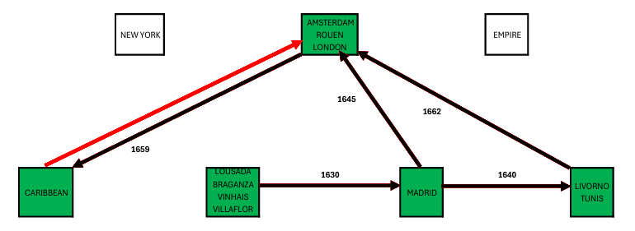
FIRST RETURN FROM THE CARIBBEAN
1672

Slide 17
THE CARIBBEAN CONNECTION
ISAAC BARUCH LOUSADA IN AMSTERDAM WAS REPLACED BY HIS SON DAVID FROM BARBADOS WHOSE DESCENDANTS TRADED WITH CURACAO AND SURINAM
ISAAC’S STEPSON AND NEPHEW AARON REMAINED IN BARBADOS AND HIS DESCENDANTS TRADED WITH MOSES BARUCH LOUSADA IN LONDON
MORE GENERALLY THE AMSTERDAM – BARBADOS AXIS EVOLVED AFTER THE TREATY OF BREDA 1667 TO
  AMSTERDAM – SURINAM – CURACAO
  LONDON – BARBADOS – JAMAICA

Slide 18
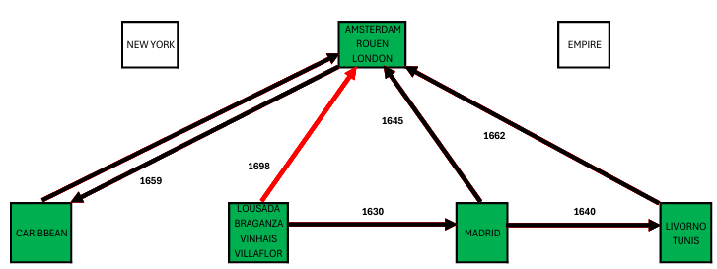
LAST EXIT FROM IBERIA
1698

Slide 19
LAST EXIT FROM IBERIA
1698
VINHAIS DAMAGED IN LINGERING CONFLICT AFTER 1640 PORTUGUESE SECESSION
LIKELY RESIDUAL LOUSADAS MOVED TO NORTHERN SPAIN
CORUNNA LINKED BY PACKET BOAT SERVICE TO FALMOUTH UP UNTIL 1701
PROBABLE 1698 ROUTE TO LONDON OF JACOB AND ABRAHAM

Slide 20
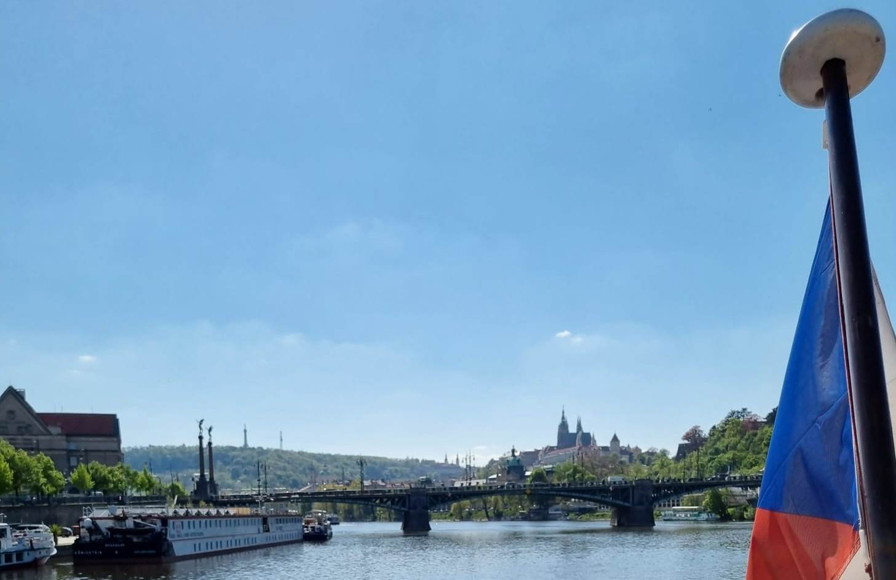
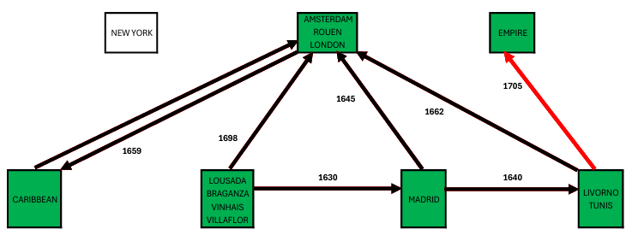
INTO THE EMPIRE
1705

Slide 21
INTO THE EMPIRE
1705
A BARUCH LOUSADA MARRIES A PRAGUE MAN circa 1705
LIKELY AN ADVENTITIOUS EVENT DUE TO BEING WIDOWED THERE
MANY ITALIAN LINKS WITH THE EMPIRE THROUGH THIS PERIOD

Slide 22
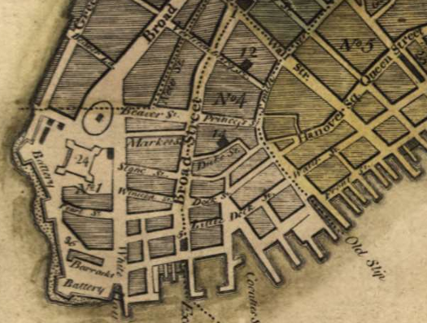
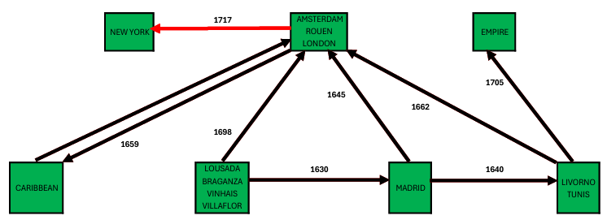
ANOTHER ENTRY TO THE NEW WORLD
1717

Slide 23
ANOTHER ENTRY TO THE NEW WORLD
1717
ABRAHAM REMAINS IN LONDON – DIES 1722
JACOB GOES TO NEW YORK IN 1717 WITH SONS
  AARON
  MOSES
PROMINENT IN CHOCOLATE, WITH CURACAO TRADING LINKS
  MANY NEW ENGLAND DESCENDANTS
  AND MANY MIDWEST LOUSADAS (NON-DESCENDANTS) DUE TO AARON GIVING HIS NAME TO A PROBABLE ADOPTED SON

Slide 24
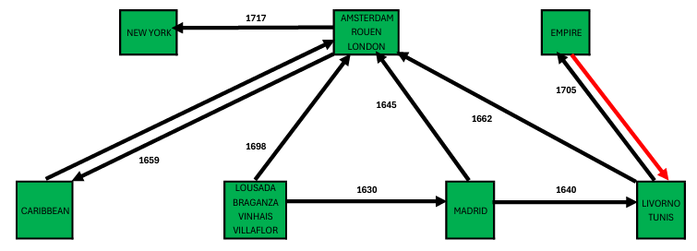
FIRST EXIT FROM THE EMPIRE
1735

Slide 25
FIRST EXIT FROM THE EMPIRE
1735
SIMON BARROW OF BARBADOS
  MARRIES MONTEFIORE WIFE IN ITALY (LIVORNO?) 1735
  EXIT TO LONDON WITH LEVI SONSINOS AND MONTEFIORES
  REACHES BARBADOS BY 1759
BROTHER STAYS ON IN PRAGUE
  A PROBABLE ANCESTOR OF RANDY SCHOENBERG
HALF-BROTHERS MOVE TO HUNGARY AND START FISCHL FAMILY

Slide 26
THE BARUCH DIASPORA PRODUCED DESCENDANTS IN:
THE NETHERLANDS (PRESENT-DAY)
THE UNITED KINGDOM (CONTINUOUS FROM 1743)
THE USA (CONTINUOUS FROM 1717)
AND OTHER FORMER BRITISH COLONIES
ELSEWHERE (HUNGARY, NORTH AFRICA, LATIN AMERICA)?
as revealed in www.barrow-lousada.org

