Slide 1

Fun with autosomal DNA? by
Julian Land
Tackling genealogical uncertainty with autosomal DNA matching
Source: www.barrow-lousada.org

Slide 2
Fun with autosomal DNA – am I crazy?
Some autosomal users will not look at matches less than 200cM
Few service providers (e.g. GEDmatch) will show autosomal matches under 7cM
But I am left with 2-4 cM matches
  The human genome = 4000cM approx
  11 generations = 1/2000 approx. = 2cM
Many problems with such small matches
  High risk of false positives
  GEDmatch changes its methodology often

Slide 3
Why not Y-DNA?
Y DNA results can be great as shown by Adam Brown, Michael Waas et al
3 specific results so far for me:
  Allan and Jeremy Lousada have a Y match – the Lousada F haplotype
  Bob Leuzarder (my Lousada 9th cousin once removed) is not a male-line Lousada despite his surname
  Edmund Barrow (my Barrow 4th cousin) has original Ashkenasi Y
But male-lines are not easy to find – in Adam’s study I am using a cousin’s DNA

Slide 4
What puzzle am I trying to solve?
  Our genealogical work covers Portugal, Spain, Italy/Tunis, France, Netherlands, Barbados, Curacao, Surinam, Jamaica, England, and New England.
  It does not prove that the various branches of the Baruch Lousada family have the same origin as there are no proven links to the Portuguese offspring of Amador de Lousada of Vinhais b1540
  Autosomal DNA is the only option to increase certainty.

Slide 5
How did I approach the problem?
Our resource is the DNA of 12 known and probable relatives
We find patterns of matches between relatives which cut through the false positive problem (idea of John Griffiths my Barrow 6th cousin once-removed)
At all times it was vital to compare such patterns with what a random sample showed

Slide 6
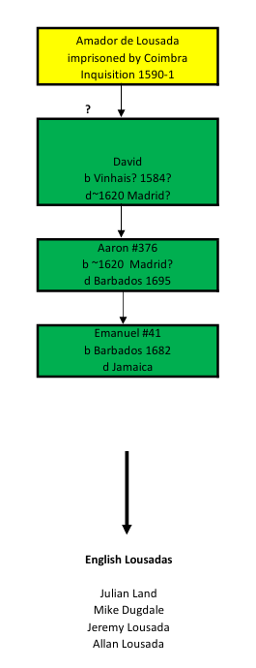
My branch of the Baruch Lousadas
We have no evidence Amador is my 9*GGF
We do not know David’s Portuguese name
Our 1st 4 relatives for DNA

Slide 7
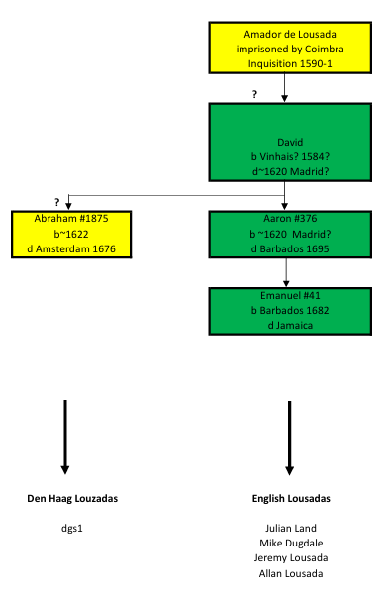
The Den Haag Louzadas
Den Haag Louzadas descend from Abraham #1875
Of Amsterdam entourage of Isaac and Abraham Israel Pereira
Like his brother Aaron #376, he was a stepson of Isaac #42 due to early death of David #1584
Bob Leuzarder has a 7cM match with dgs1 a Querido/Louzada descendant – perhaps our only present-day connection with the Den Haag Louzadas

Slide 8
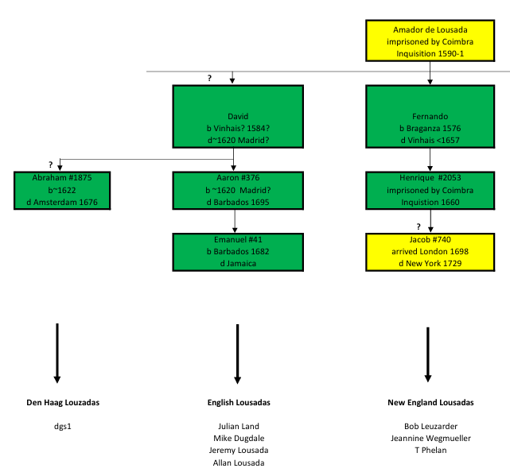
The New England Lousadas
Suggested son of Henrique
Jacob and his brother Abraham left Iberia at the time
the Falmouth packet boats left from Corunna in Spain
Bob matches Jeannine (a Luzarder) and
T Phelan (a Papacin-Louzada)
Our next 3 relatives for DNA

Slide 9
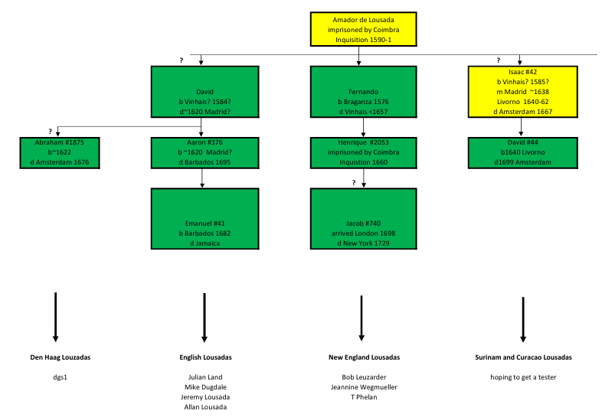
The Curacao and Surinam Baruch Louzadas
Previously discussed

Slide 10
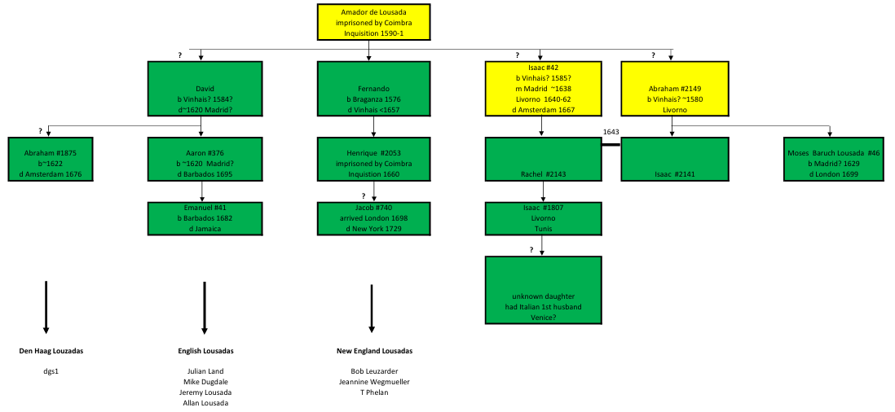
Livorno – another ancestral brother?
The well-known Moses
Baruch Lousada of London Is probable son of Abraham #2149
Isaac #1807 has his father’s name
This joint great-granddaughter is a key ancestor in what follows

Slide 11
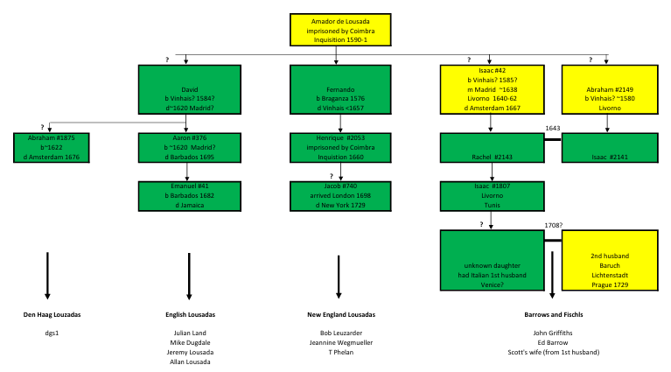
Origin of the Barrows and Fischls
We do not know the name of Baruch’s wife or her first husband
We don’t know how she got to Prague
and suggest she was widowed there
3 more relatives for DNA

Slide 12
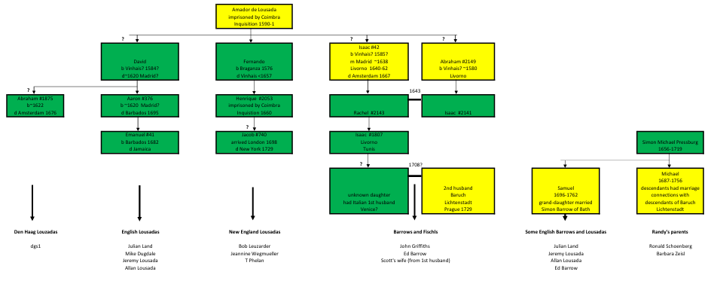
Pressburg connection

Slide 13
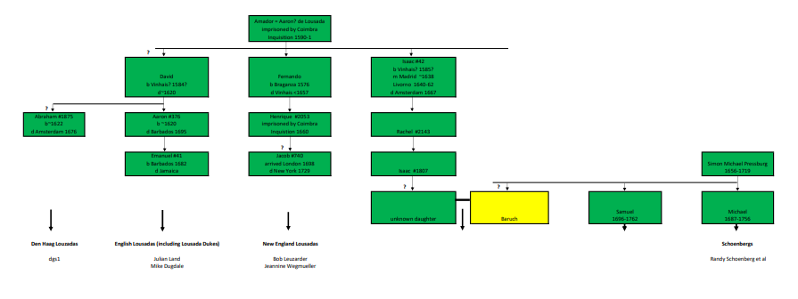
Randy Schoenberg’s Pressburg connection

Slide 14
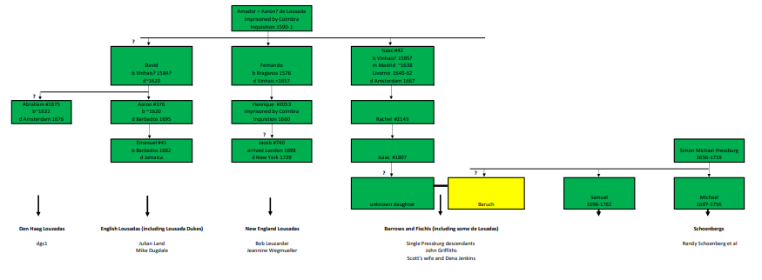
Single Pressburg connection

Slide 15
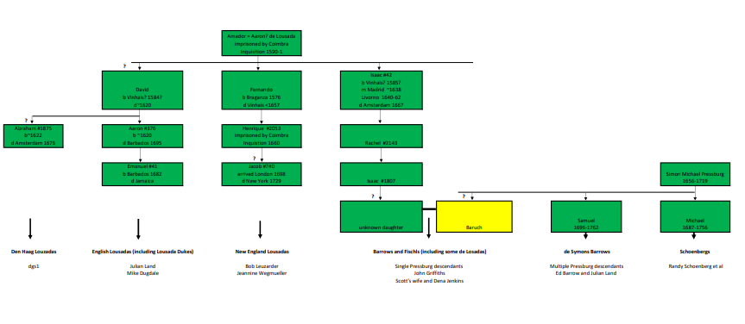
Multiple Pressburg connections

Slide 16
Our research project
Each of the 3 stages
used GEDmatch set at 3cM
but each used a different GEDmatch methodology for deciding what was a match
  The change from stage 1 to stage 2 was made unwittingly!
  The change from stage 2 to stage 3 was made on GEDmatch advice

Slide 17
Stage 1
in 2022
6 relatives
  Julian
  Mike Dugdale
  Jeannine Wegmueller
  John Griffiths
  Ed Barrow and
  Scott’s wife

Slide 18
Stage 2
in 2024
with GEDmatch technology much better at picking up matches between relatives than between random people
7 relatives
Bob added

Slide 19
Stage 3
in 2025
using the GEDmatch Qmatch technology – GEDmatch’s improved technology for small segments
12 relatives
  Allan and Jeremy Lousada (known relatives) added
  T Phelan added (probable relative – new match discovered by Bob)
  Randy’s parents added (they showed the 3 Lousada indicator locations arising from Stages 1 & 2)

Slide 20
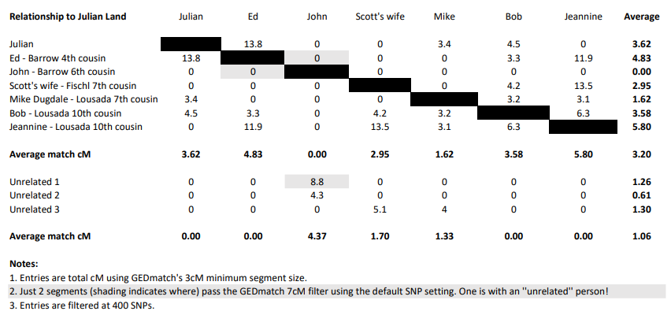
Total cM matches
Lousada relatives have a bigger average match 3.20 cM
with each other than with 3 unconnected people 1.06cM
(but not statistically significant?)

Slide 21
Stage 1 outcomes
14 interesting multiple matches were identified after comparison with matches between random people
Set out in next slide
2 of the matches were outstanding
We found a very unusual phenomenon which pointed to a diagnostic for judging matches
This was a coincident boundary involving 4 individuals

Slide 22
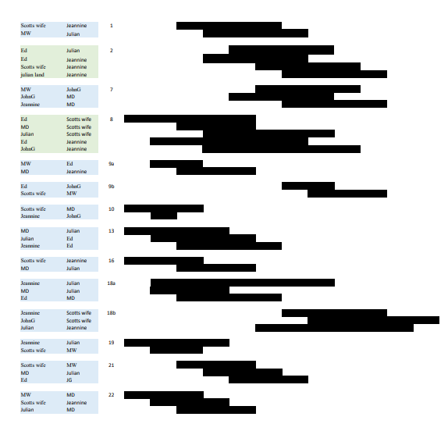
14 interesting multiple matches

Slide 23
The 2 outstanding Lousada matches in Stage1
Chromosome 2 (218782054 - 219513782) a 1.3cM segment
  4 people in this match, bridging 4 family branches
  3-way triplet intersects a 3 to 1 match
Chromosome 8 (52269392 – 54277280) a 2.7cM segment
  This match represents all 6 of the probable Lousadas in the sample
  The 3 to 1 match is reinforced by the coincident segment boundary at 52693392
  Showing Julian, Scott’s wife, John Griffiths and Jeannine Wegmueller
  The odds against such a coincidence are lower than 7000 to 1 against

Slide 24
Stage 2 outcomes
Cr2 and Cr8 common segments generated more overlapping matches at each of these locations
An additional multiple overlap on Cr21 was identified
I suggested these 3 multiple matches could reflect Lousada indicators
The coincident segment boundary on Cr8 survived

Slide 25
Stage 3 outcomes
The Cr2, Cr8 and Cr21 indicator segments were examined
Using Qmatch technology set at 3cM and Precision = 3
This revealed 7 more coincident boundary segments (3 on Cr2, 2 on Cr8 and 2 on Cr21)
These 7 coincident boundaries show specific genetic events linking the relatives
The next 2 slides show why

Slide 26
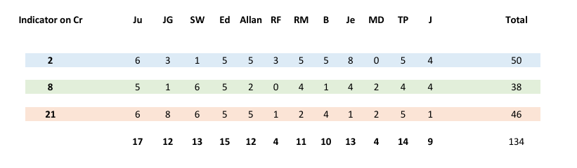
How the relatives appear in matches at the 3 indicator segments
There is a rough parallel with degree of Baruch Lousada ancestry
Julian (with Allan) has the most
MD has the least
All others have a double dose due to consanguinity

Slide 27
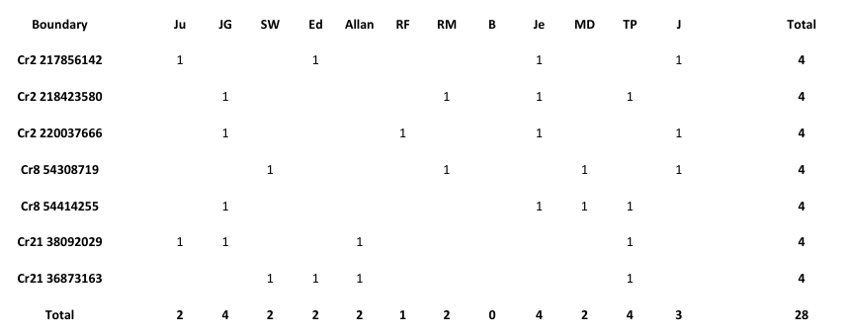
Relatives appearing at the coincident segment boundaries
As each group of 4 people shares a genetic connection, together we can see that 11 of the 12 are all connected to each other

Slide 28
Sequel to our research
The 3 indicators though useful are not perfect
  non-exclusive – they appeared occasionally in matches with the random sample
  Lousadas do not always show them due to generational loss of autosomal DNA
So we became highly alert to the exact information conveyed by the coincident segment boundaries
Fortune favours the prepared mind!
For we were lucky enough to discover another type
This time they were disjoint contiguous segment boundaries
These are much easier to interpret and thus much more powerful
We show our 1st examples in the next slide

Slide 29
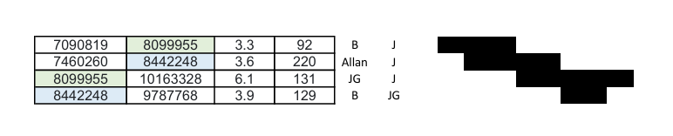
The 2 disjoint contiguous segment boundaries we found in early 2025
Abutting mismatches arise from complementary gametes
8099955 shows B and JG descending from a pair of complementary gametes
With Jeremy descending from one of the parents (or an ancestor thereof)
8442248 shows one of Jeremy or Allan descending from the same parents as Bob and John G
Allan and Jeremy have the same ancestry by genealogy, and also by Y
Hence all 4 come from the same family!

Slide 30
Conclusion
English Lousadas, New England Lousadas and Barrows all descend from the same family
The family of Amador de Lousada of Vinhais now a much more probable source
Because the possibilities of individual sources are eliminated
The earlier work still supports:
  The probable Lousada origins of the Fischls; and
  The probable Lousada ancestry of Randy’s parents
Improbable segment boundaries, especially the disjoint contiguous segment boundaries, may provide a basis for AI searching for remote families

Slide 31
Where 2 people match a third person
They do not necessarily match each other
How can this be?
The 2 matching people are independently matching opposite pairs of the third person’s relevant chromosome
None may be a Lousada but even if one person has a Lousada match the other won’t!
We call these situations ‘weak triples’

Slide 32
Residual interesting matches
Deleting the weak triples for the reason just explained
  Noting they consume 18 segments out of 57
  This leaves 39 segments
  Making up 14 multiple matches involving 4 to 6 people
These 14 matches must now be reviewed

Slide 33
Reviewing the 14
To ensure we had our wits about us:
A parallel study was conducted of 7 random people not obviously connected with each other
Here, 146 segment matches were found, of which 93 did not overlap other segments leaving 53 overlapping segments
Of these, 10 cases are weak triples
  We explained why such cases are dismissed
Our random group thus generated 12 multiple matches
  These demonstrate that many types of complex matches can arise at random
  Even including strong triples we now discuss

Slide 34
First type of strong triple
3-way triplets do not imply all 3 have identical half-ancestry
Either half-chromosomes at a site can provide a match
3-way triplets arose in our random sample as well as in our ‘’Lousada” sample
A has Lousada match with B
B has Lousada match with C
C has Lousada match with A
A has Lousada match with B
B has non-Lousada match with C
C has non-Lousada match with A
YES
NO

Slide 35
Second type of strong triple
A matches B, C, and D at the same site
Cannot have 3 independent matches at same site as explained above
SOLUTION
  One of AB, AC or AD is a false positive
OR
  All have the same DNA at the site
  With a false negative or two (depending on what other matches show up at the site)

Slide 36
Which of our 14 survive?
From our Lousada group
Only 2 matches to consider for proving Lousada links
These matches involve 4 people in one case and 6 in the other
The other 12 matches (involving 4-6 people!) are not decisive enough
Comparison with the random sample reveals:
  The 12 rejected matches are similar to those in random 12
  A difference exists in the strong triples

Slide 37
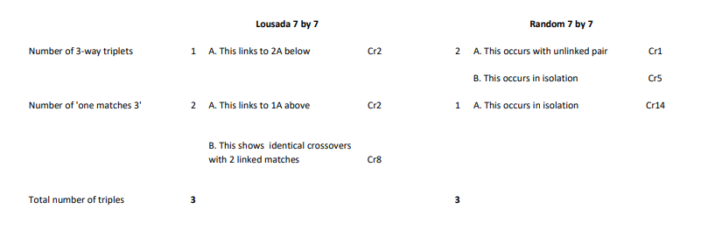
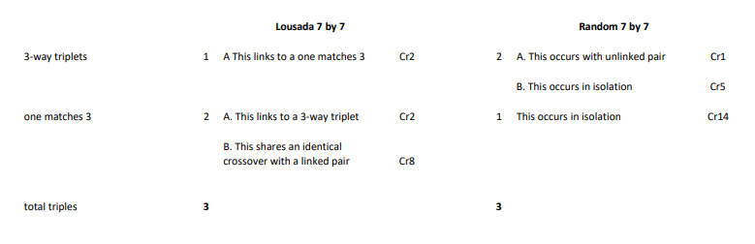
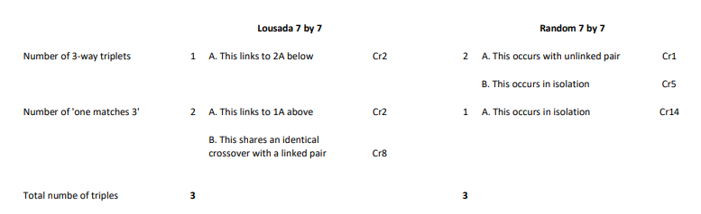
The strong triples
  The same number of strong triples occur
  The Lousada strong triples are all reinforced and are less likely to be random
  None of the random strong triples are reinforced

Slide 38
Why are these matches persuasive?
Chromosome 2 (218782054 - 219513782) quite suggestive but
  Jeannine possibly shows false positive with Ed (not critical)
  Jeannine possibly shows false positive with Scott’s wife (potentially a fatal flaw)
Chromosome 8 (52269392 – 54277280) vastly reduces doubt
  A coincidental crossover at 52269392
    Shows Scott’s wife shared Lousada genetic history with Julian, JG and Jeannine
    Occurred before Pressburg connection (Jeannine not a Pressburg descendant)
  The other coincidental crossover at 54277280
    Confirms Scott’s wife has pre-Pressburg Lousada genetics (since MD not a Pressburg descendant)
    Julian’s and Ed’s Pressburg ancestry starts to differ as from the time of the siblings Simon and Bella Barrow
The study thus provides comfort in our genealogy extending across 5 family branches
  6 rejected matches now appear supportive but 5 remain rejected
  The final match remains rejected here but has a Pressburg significance

Slide 39
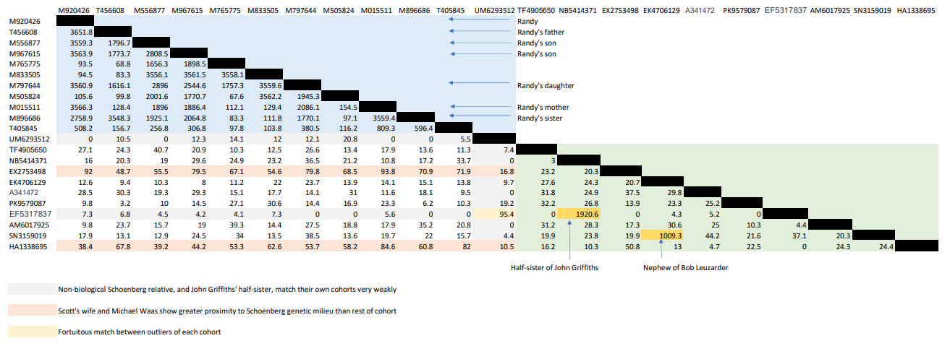
Introducing the Schoenberg DNA & its Lousada matches (total cM)

Slide 40
How does the last chart help?
It contains data relevant to
  The Barrows’ original Pressburg connection via Baruch
  Multiple Pressburg ancestry via Baron Lyon de Symons
A specific segment emerges
  rejected in the Lousada context
  but in the Pressburg context it is much more interesting

Slide 41
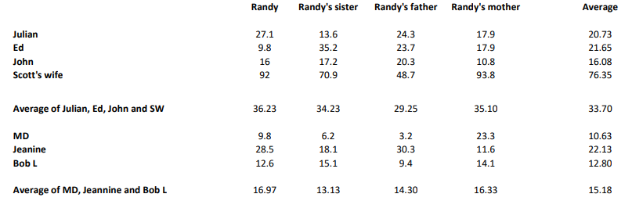
Extract from Schoenberg chart
John (a generation younger than Julian and Ed) may effectively show more not less Pressburg DNA than Julian and Ed
Non-Pressburg descendants average a reduced Schoenberg match
Of course these suggestions are not proven statistically significant

Slide 42
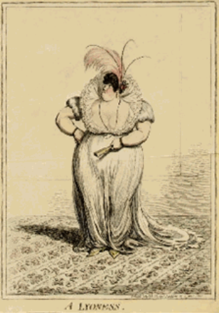
Possible Pressburg implications
The English Barrows may not inherit extra Pressburg genes
If proven, Baron Lyon de Symons
  Not the biological father of Tryphena Barrow nee Lyon de Symons (birthdate unknown)!
  What a formidable woman was the Baron’s wife!
  Who knows the circumstances of her marriage?

Slide 43
Possible Pressburg implications
The English Barrows do not appear to inherit extra Pressburg genes
If proven, Baron Lyon de Symons
  Perhaps not the biological father of Tryphena Barrow nee Lyon de Symons (birthdate unknown)!
The Barrows may have just a single dose of Pressburg genes
  acquired from Baruch whom we suggest was another son of Simon Michael Pressburg
  Baruch’s only feasible birthdate would seem to have been 1681 making him the oldest
  the Fischls may be more closely connected than the Barrows

Slide 44
A Pressburg segment?
At the same site on Chromosome 21 36186352-37809408 3cM
  Randy matches Julian and John
  John matches Randy and Ed

Slide 45

There are some difficulties
  Ed does not match Randy or Julian
    False negatives?
  And we need to explain away the first 2 of these following matches
    Perhaps the SW/MW match is non-Pressburg
    and the MD match is on Julian’s paternal side

Slide 46
Nevertheless
this is a promising match which points to shared Pressburg ancestry
and future work?

Slide 47

Acknowledgements:
John Griffiths, my data analyst 6th cousin (once-removed) for inspiring me to tackle autosomal DNA
Randy Schoenberg for all the relatives he put onto GEDmatch and for the identity of the Prague father of Simon Barrow of Barbados
Adam Brown and Michael Waas for Y advice
Jarrett Ross for advice on my Sephardic and Ashkenasi connections with the Nunes Vas family, and also for his work on my Querido ancestry
My relatives who were brave enough to offer their DNA to my studies
To Bob Leuzarder for his diligent genealogy
Dena Jenkins who overcame her reluctance to share ancestral information

